Slide 1
Charitable Gift Annuities: What’s Best Practice
Notes:
The information in this presentation is a suggested system of best practices developed by the American Council on Gift Annuities to help charities manage risks in their charitable gift annuity programs and protect charitable gift annuity donors.
The presentation has three focus areas:
*Establishing the program properly
*Prospect Relations, Disclosure & Closing the Gift
*Investing, Reporting & Stewardship

Slide 2
About Charitable Gift Annuities
First Charitable Gift Annuity issued in U.S. in 1830
Total value of CGA’s reported in 2017 Survey1 – More Than $3.2 Billion
CGA’s have both risks and rewards for charities and their donors
¹ACGA 2017 Survey of Charitable Gift Annuities (hereafter “2017 Survey”)
Notes:
Charitable Gift Annuities (CGA’s) are a very popular form of planned gift
CGA’s are easy for the donor prospect to understand and complete
CGA’s are an easy giving plan for charities to explain to prospects
********************
The “risk” in CGA’s for charities is in the fact the agreed on income stream (annuity payments) are a legal and financial obligation of the charity
The “reward” for charities is this giving plan promotes long-term relationships with donors that may result in additional gifts and/or referral of other prospective donors

Slide 3
Establish Program Properly
Notes:
Development of appropriate policies and procedures is a key step in developing a strong CGA program.
Key elements of a good charitable gift annuity program:
Financial Stability
Financial Reserves
Long-term Commitment to Administering CGAs

Slide 4
Comply with Federal and State Regulations
Philanthropy Protection Act of 1995
State Regulatory Requirements
Notes:
Know both state and federal laws that regulate charitable gift annuities and make sure your organization has procedures in place to be able to comply with all.

Slide 5
Philanthropy Protection Act of 1995
Exempts charitable funds, including charitable gift annuity reserve funds, from the Investment Company Act of 1940
Disclosure Statement must be given to prospective donor
State regulations may require specific disclosures
The ACGA recommends charity have donor sign a copy of the Disclosure Statement
Notes:
The Disclosure Statement should be provided as a part of a CGA illustration/proposal packet to a prospective donor.
Key information that must be included in the Disclosure Statement:
*The existence of a contractual relationship between the charity and the donor
*That charity’s obligation under the CGA contract/agreement is a general claim on the charity’s assets
*The existence of a reserve fund that complies with state law
Charity may also want to include information about the charity and its investments in the Disclosure Statement

Slide 6
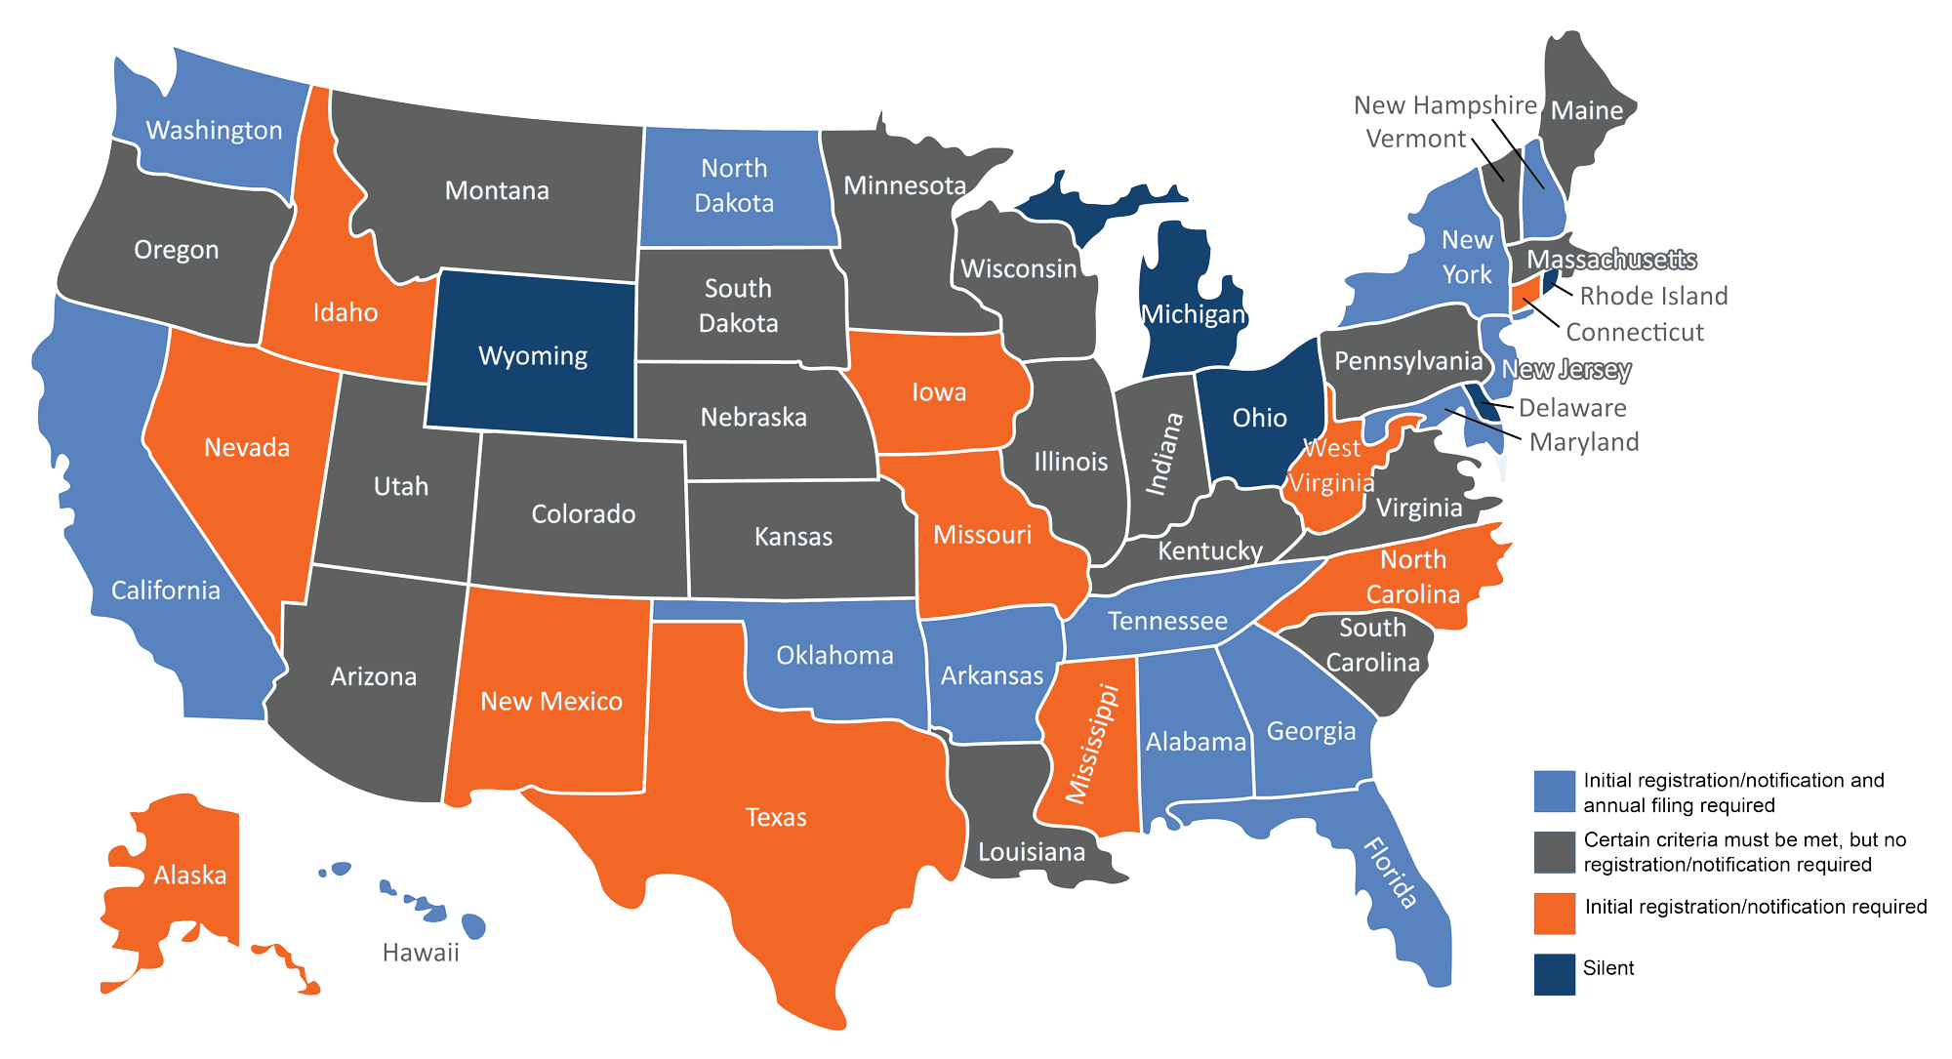
State Regulatory Requirements
Five states are “Silent”
All other states have some level of regulation
Multiple state laws may apply if donor and charity are “residents” of different states
Regulations range from meeting certain criteria to registering only to registering and filing an annual report
Go to www.acga-web.org for current information on state requirements
Notes:
“Silent” states have no specific statute mentioning CGA’s (Delaware, Michigan, Ohio, Rhode Island and Wyoming).
Key point in time, in determining what state law applies, is when the gift annuity contract/agreement is signed---where is donor a resident and where is charity’s principal place of business.
State regulation criteria include but is not limited to: type of organization issuing the gift annuity (exempt from federal taxation; religious organization; file Form 990); number of years in existence/operation; reserve fund requirements and investment restrictions; board resolution approving organization’s charitable gift annuity program.

Slide 7
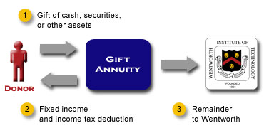
Specify Type of Assets That Will Be Accepted
Most common:
Cash and Appreciated Securities
Accepting Real Estate, Tangible Personal Property and/or other types of assets requires planning / special policies
Hard-to-sell assets create liquidity issues in annuity reserve
Gift Acceptance Policies should include procedure for varying from policy
Gift of cash, securities
or other assets
Charity
Fixed income and
income tax deduction
Remainder
to Charity
Notes:
Best practice is to allow gifts of real estate, tangible personal property, and other property interests to be used only to fund deferred gift annuities so that organization has time to liquidate the asset before it has to start making annuity payments.
Also consider, if state law/regulation permits it, lowering the annuity payment rate below the ACGA suggested rate if a hard-to-value/hard-to-sell asset is being used to fund the gift.
Gift Acceptance Policy “variance” procedure should include a statement as to who can agree to a variance from standard policy and how such exceptions are made.

Slide 8
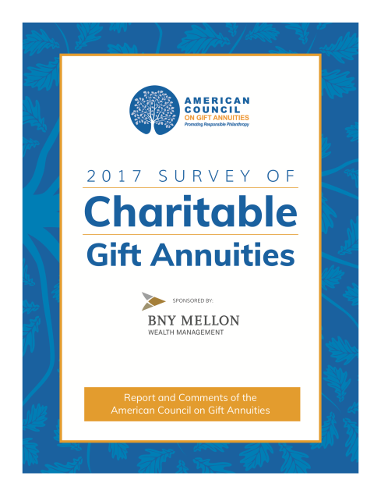
Establish Minimum Ages
For Immediate Gift Annuities
The average age of an annuitant at the date of gift was 79 per 2017 Survey
Minimum age policy:
32% of 2017 Survey respondents had a minimum age policy of 65
25% of 2017 Survey respondents had a minimum age policy of 60
Notes:
Establishing a minimum age policy for annuitants provides protection to both the annuitant and the charity. CGA’s may not be appropriate for younger donors---fixed payments offer no inflation protection. Entering into a CGA with a young annuitant may provide little benefit to the charity because of the long-term administrative expense and staff time commitment to steward the gift.

Slide 9
Establish Minimum Ages
For Deferred Gift Annuities
Focus is on age when annuity payments will start
Best to require age at payment starting date to be same as minimum age of immediate CGAs
Consider also having a policy regarding minimum annuitant age at date of gift
Notes:
Having a policy that sets a minimum current age of the DGA annuitant at the time the gift is made keeps the term of the administration of the gift, both during the deferral period as well as the annuity payment period, to a reasonable period of time, thereby better assuring the charity will benefit from the gift.

Slide 10
Establish Minimum Gift Amounts
59% of respondents to 2017 Survey required a minimum gift amount of $10,000 - $24,999
Religious organizations tend to have a lower minimum gift amount
Consider also a policy regarding maximum gift amount
Notes:
Establishing minimum gift amounts assures the amount the charity realizes from the gift justifies the organization’s efforts and expense in developing the gift and administering it.
Having a maximum gift amount policy is another component of risk management as it better assures the charity does not have too few “eggs” in one basket.

Slide 11
Follow ACGA Suggested Maximum Rates
97% of 2017 survey respondents always or usually follow the ACGA rates
The ACGA rates have credibility with state insurance departments
Using the ACGA suggested rates puts the focus on the gift rather than the “investment” aspects of CGAs
Minimizes or relieves need to obtain actuarial verification to support organization’s rate schedule
Viewed by many as the industry standard
Notes:
*The Rates Committee of the ACGA Board reviews the suggested maximum gift annuity payment rates on a regular basis. If the Rates Committee determines changes in the suggested rates are advisable, the Rates Committee recommends changes to the ACGA Board.
*Changes in suggested maximum gift annuity rates are usually made at the spring meeting of the ACGA Board with an effective date of July 1 of that year. Notwithstanding the forgoing, if economic conditions warrant a change at another time, the ACGA Board will consider and act on such a recommendation whenever it is presented.

Slide 12
Establish Procedures to Ensure Gift Designations Honored
Procedures should be in place to calculate residuum of CGA at annuitant’s death
Beware of overly-specific donor restrictions
Notes:
Nothing is more harmful to a planned giving program than the charity not doing what it has agreed to do.
Procedures for calculating the residuum of the CGA at the annuitant’s death assure the proper amount is withdrawn from the CGA pool/reserve.
While a donor-designated use for the residuum may be needed and/or appropriate at the time the gift is made; that need may no longer be there at the donor/annuitant’s death years later. Discuss with the donor alternate uses in the event the designated use/program is no longer needed or in existence.

Slide 13
Establish Appropriate Contract Termination Procedures
Termination at annuitant’s death:
Send letter of condolence to family
Obtain Death Certificate
Notify Business Office to Stop Annuity Payments
Notify executor of potential posthumous tax deduction
Termination during annuitant’s life:
Annuitant disclaims annuity interest
Calculate Charitable Contribution Value

Slide 14
Prospect Relations, Disclosure and Closing The Gift
Notes:
Once your program has been established properly (or fine-tuned) with guidance of competent legal counsel your organization is ready to move forward to meet with donor-prospects and close gifts. Focus on: developing satisfied donors and long-term relationships; increasing the potential for repeat gifts; and creating a culture where existing donors are so pleased with what they have done with your organization they refer their friends and family as new planned giving prospects for your organization.

Slide 15
Meet With the Donor
Planned Giving development best done through face-to-face interaction
Allows you to assess donor’s understanding of the transaction
Irrevocable Gift
Difference Between Gift Annuity vs. Commercial Annuity
Tax implications
Use of gift by organization
Review Specimen CGA Contract/Agreement with donor
Encourage review of illustration and documents by donor’s advisors
Notes:
Face-to-face interaction is helpful both as you initially engage with a prospect and also when the illustration of the proposed gift is presented to the prospect.
If face-to-face interaction is not possible, as is the case for many national organizations, interaction with the prospect should be done through telephone calls, video conferencing, emails and snail mail.
Make sure your prospective donor understands the illustration is a model, not what will actually happen if they establish a CGA with your organization.
Include a disclaimer on the gift annuity calculation in the illustration to highlight that the information is for illustration purposes and that the actual results will likely be different.
Making the donor’s advisors “part of the team” is beneficial to both the charity and the donor-prospect. Encouraging the donor to review the illustration and all documents with his/her own advisers assures someone representing only the donor’s interests is aware of what the donor is planning, understands why the donor is making the gift, and can gauge whether or not the donor understands what he/she is doing.
Consider inviting the donor’s advisor(s) to attend meetings with the donor and your organization’s representatives.
You may also want to encourage your donor to notify his/her family about the charitable gift they are considering (or have made) so the donor’s family’s expectations regarding estate disposition are managed and there are no surprises at the donor’s death.

Slide 16
Marketing Your Gift Annuity Program
It’s a gift not an investment
Avoid financial instrument terminology
Make it clear – Gift is Irrevocable
Don’t use “Guaranteed Income”
Donor testimonials are powerful
Notes:
Make sure all CGA marketing materials are clear and accurate.
Make marketing materials friendly to older donors --- use 12 point font, paper stock that is not too thin or shiny, and black ink on a white background with plenty of open space on the page.
Financial instrument terminology to avoid: “product”; “yield”; “rate of return”; “purchase”.
Instead of “guaranteed income” use “fixed payments for life”----the annuity payment is not “guaranteed” in the legal sense even though it is backed by the organization’s general assets and it’s not all “income” (dividends and interest) as a portion of each payment is a return of principal (that’s the “tax free” portion).
Make sure all marketing materials include a disclaimer that the information provided is not (and is not intended to be) legal or tax advice and the advice of the prospect’s own legal and tax advisers should be sought before a gift is made.
And, if your organization is not registered to issue charitable gift annuities in all states that require registration and/or notification, include a disclaimer on your marketing materials stating “Not Available in All States”.

Slide 17
Who Signs Gift Annuity Contract
Review contract with donor (and donor’s advisor(s)) before it is signed
Both donor and charity representative should sign
Provide donor with a copy of fully-signed contract
Notes:
Having both the donor and the charity sign the CGA contract shows the donor was provided with the terms of the transaction and both parties agreed to the terms presented to the donor.

Slide 18
Tax Reporting
Gift Acknowledgement “Package”
Acknowledgement letter which includes description of asset gifted
Finalized Charitable Contribution Calculation
Finalized “Taxation of Gift Annuity Payments” Report
Sample IRS Discount Election Statement (if applicable)
Report annual annuity income to annuitant on Form 1099-R
1099-Rs must be sent to annuitants on or before January 31 each year
Notes:
If something other than cash is used to fund the CGA, Federal tax law requires only a description of the gifted assets to substantiate the charitable contribution.
Make your donor aware of the annual tax reporting via the Form 1099-R at the time the gift is completed so they will be on the lookout for it.
Consider sending a second copy of the final charitable contribution calculation in January of the year following the year of the gift since donors sometimes misplace it. If sent early in January, include a reminder a 1099-R will be sent to them by January 31 that year and each year thereafter.

Slide 19
Investing, Reporting and Stewardship
Notes:
CGA’s can be in force for many years; therefore, best practices don’t end with development of appropriate policies and procedures, compliance with regulations, and marketing and closing gifts. Your organization must apply best practices to the investment of the gift annuity reserve and stewardship of the relationship with your donors and annuitants.

Slide 20
Investing
Invest entire amount of gift
Use an appropriate custodian / investment advisor
Gift Annuity Reserve should be (may be required to be) invested conservatively
The ACGA Suggested Payout Rates Asset Allocation Assumption:
40% Equities
55% 10-Year Treasury Bonds
5% Cash and Equivalents
Notes:
Investing the entire amount of the gift is the most prudent course of action. Not investing the entire amount may result in your organization’s reserves being insufficient to meet its annuity payment obligation. The 50% residuum assumption used to develop the suggested maximum gift annuity rates is based on the full amount of the gift being invested. Investing the entire amount allows the organization to self-insure and it is a good marketing tool as it shows the strength of the organization’s reserve fund.
The ACGA suggested payout rate asset allocation actuarial assumption is not the actual asset allocation most charities use for their CGA pool (Respondents to the 2017 Survey reported, on average, a 10% cash, 51% stocks/mutual funds, 14% government bonds, 16% corporate bonds, 2% real estate and 7% other investments asset allocation).
If possible, keep CGA pool separately invested.
Asset allocation is the primary driver of investment return. The organization must select an asset allocation appropriate to it’s unique circumstances and preferences.

Slide 21
Establish Method for Determining Residuum
Track each contract’s share of reserve fund to determine if any “underwater”
Residuum calculation important for designated use/purpose gifts

Slide 22
Relationship Between Development Office and Business Office
Development Office maintains primary relationship with donor/annuitant
Business Office handles investment, administration, coordination with banking/administrative partner and tax reporting
Keep lines of communication between both offices open
Notes:
The development office’s relationship with the donor/annuitant should continue even after the gift is completed. The donor/annuitant should be encouraged to contact the development officer regarding any matters related to their CGA.
Keeping the lines of communication between the development and business offices open is key to good donor/annuitant stewardship---the business office should keep the development office updated on when 1099’s will be mailed each year and the development office should notify the business office about all calls from the donor about administration of their CGA.

Slide 23
On-Going Communication With Donors and Annuitants
Regular, clear communication important
Maintain and nurture relationship
Newsletters, birthday and holiday cards, invitations to special events
Timely, accurate tax and other reporting
Potentially long-term relationship
Notes:
Keeping in touch with donors and annuitants is an obligation and a privilege. The donor has made your organization a part of his/her long-term plan to accomplish personal goals and objectives.
On-going communication will help the donor feel valuable and that he/she has made an important contribution to the furtherance of your organization’s mission. Such communication may result in additional gifts and/or good word of mouth “advertising” to the donor’s friends and family.

Slide 24
Educating Colleagues and Constituencies About CGAs
Makes promotion of CGAs more effective
Be sure Board/Trustees understand both benefits and liabilities of CGAs
Broadens “prospecting” opportunities and enhances stewardship efforts
Notes:
Educating colleagues better assures none are surprised when they discover there will be no immediate benefit (dollars) when a new CGA is established.
The more well-managed your CGA program, the more value accrues to your donors and your entire organization.

